Slide 1


Security of Microservices Deployment in Cloud Containers
Timothy Fabelurin

Slide 2
Outline
1
Project Aim and Objectives
2
Background Information
3
Research Questions
4
Project Methodology and Approach
5
Results and Discussion
6
Summary and Future research

Slide 3
Project Aim and Objectives
The aim of this project is to:
Implementation of a framework for the security of microservice application in cloud, developed by investigating vulnerabilities associated with containerization caused by cooperation and orchestration of middleware, the container images and the application source codes, during and after the deployment of the microservice application in cloud.

Slide 4
Project Aim and Objectives
The Objectives of the project are as follows:
To identify the sources of vulnerabilities that exist in all stages of the deployment of microservices application in cloud.
To implement a microservice environment in cloud with defence mechanism in place
To Monitor the implementation using trusted tools and analyse the reaction and performance of the system with and without the defensive measures.
To develop a framework by putting together the procedure and results obtained from the project implementation in a web application format.

Slide 5
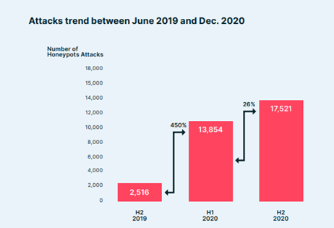
Background Information
The rate of acceptance of the Cloud Native Applications is high in about a decade of its existence, so also is the growth in the cases of security breaches of software applications developed using this technologies. This clearly indicates that there is an urgent need to review the existing security pattern which appears to be deficient.

Slide 6
Research Questions
What are the points of attacks on the cloud infrastructure that can affect microservice application?
What are the points of attacks that can be generated from within the microservice application?
How can vulnerabilities be identified before the application is deployed?
How can the vulnerabilities be checked on the pipeline/DevOps vulnerabilities?
How can unsecure loopholes be checked within the deployed microservice application?
How can effective Monitoring, Logging and Auditing be achieved?
What framework is available guidance in implementing secure microservice application in cloud?

Slide 7
Project Methodology and Approach
The type of research methodology used was Applied Research. It aimed at searching for solution to the menace of increasing cyber insecurity with microservices applications deployed in cloud containers. More specifically, carrying out evaluation research method by analysing the existing technologies and fragmented procedures with the intension of formulating a practical and implementable framework for a secured applications deployment in cloud containers.
The data collection method in evaluation research was qualitative research which has a rich, in-dept narrative description of the techniques. The result obtained in the implementation of the procedures were critically observed and the effects analysed.

Slide 8
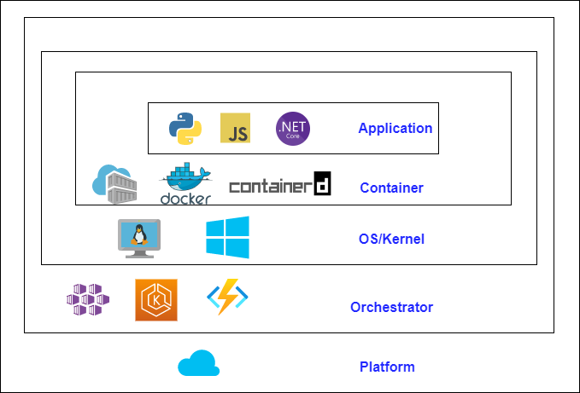
Approach Used
While traditional development process abandoned the testing and security checks to the very last stage of the cycle and send the result analysis to the developer and operation team are informed to fix the vulnerabilities captured, in shift left method, security measures are implemented during the entire cycle and the test at each stage ensures vulnerabilities are quickly identified and fixed at the earliest stage. The whole new process removes bottlenecks, improve quality and more affordable to tackle security issues.

Slide 9
Tools Used
Azure Active Directory serves as the access and identity management for implementation. Controlling access to resources with Azure and Github
GitHub serves as source code repository (That is, where codes are hosted)
SonarCloud Scanner checks the source code to identifying vulnerabilities using advanced security features.
Snyk for conducting Software Composition Analysis for compliance and vulnerability checks of third-party tools
OWAPS ZAP check the vulnerabilities after the application is running
Azure Pipelines provides CI/CD service which build and release the application automatically.
Azure Container Registry host the Docker container images and the images are scanned in this container haven been integrated with Microsoft Defender for container.
Azure Kubernetes Service provides a fully managed Kubernetes cluster on Azure for security and availability of the whole infrastructure.
Terraform is for infrastructure automation. It automatically scales the resources based on defined conditions.
Azure Policy enables the creation, assigning and the management of policies which in turn enforce rules over all the resources in the cluster. It also integrates with AKS.
Azure Key Vault is used to securely store sensitive information like connecting strings, certificates, tokens, and other secrets.
MySQL DB is a database service which is compatible with many APIs.
Monitor: Prometheus and Grafana are third party tools whose function is to constantly retrieve the health, security and performance status of the components and display status respectively.

Slide 10
Results and Discussion
The implementation of the security strategy was divided into five (5) stages and at each of this stages, unique security measures and processes were put in place. The following slides briefly show the implemented security measures at each layer and their significance.

Slide 11
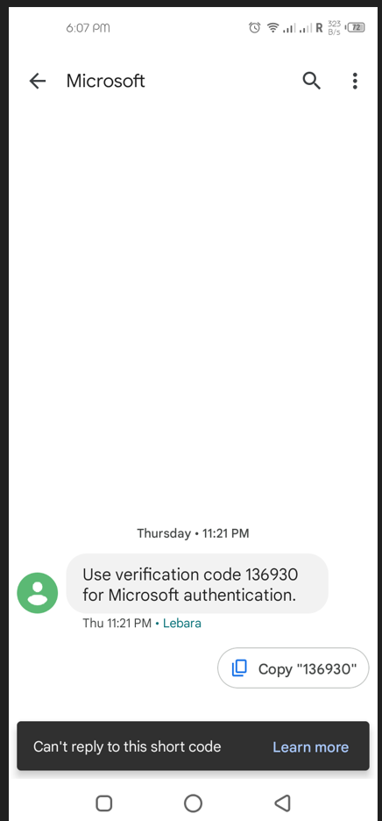
Platform Layer
Multifactor Authentication
Conditional access Policy was used to enforce MFA. all affected users needs to authenticate with either SMS, Phone call or Microsoft Authentication App in conjunction with their passwords.
Role-Based Access Control
With this feature in place, if by any chance, an attacker gain access into the cloud environment, if the authorization is not explicitly provided to access the cluster, the attacker will not be able to perform any act.

Slide 12

Orchestration Layer
Key vault
This is the recommended way of managing secretes in cloud with all values stored in key vault. The content of the vault can be key or certificate or as seen in the demonstration above, secrets. Only specific secret in a specific key vault can be accessed after permission is expressly given.

Slide 13
OS/Kernel Layer
Implementation of AppArmor
The aim of this is to ensure that not only is the kernel protected from intruders with malicious intent accessing it, but also it does provide logical isolation of the containers from the underlying node in the Kubernetes cluster

Slide 14

Container Layer
Microsoft Defender for Cloud
Azure Policy
For container security to be effective, the security implementation needs to be from the Built time to Ship time all the way to Run time. The standout point of this segment is the ability to put systems and tools in place to detect, deny malware binaries, vulnerabilities, and compliance and configuration violations in real-time. With this configuration, attacks like Zero days attack will be effectively tackled.

Slide 15

Application Layer
Static application security testing
SAST is a testing methodology that analyzes source code for identification of vulnerabilities which makes applications susceptible to attack. It is often referred to as White-box testing.
Software Composition Analysis
There are usually open-source components, supporting libraries and other dependencies that are used in developing applications, SCA scans the code base to provide visibility into these software components, the license compliance, security vulnerabilities and potential exploits.
Dynamic Application Security Testing
This is a type of black-box (the application tested from outside representing hacker’s approach) security testing in which dynamic test are performed on the application. Usually done at the end of the development cycle.

Slide 16
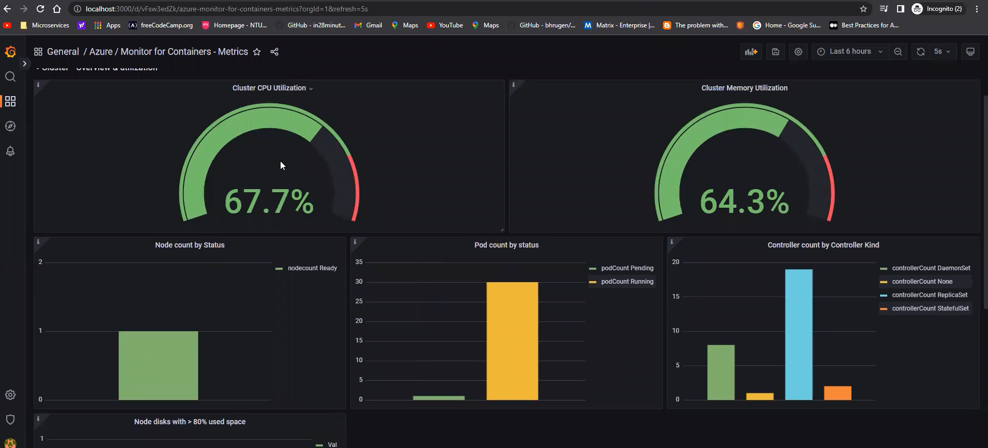
Performance Test
Load test
Apache Jmeter tool was used to generate loads of HTTP request to a user management application (20.118.12.28) deployed to AKS. CPU and Memory utilization are becoming high without any form of implementation to handle the situation.
Resiliency
To create some resiliency in the system, Horizontal Pod Autoscaler was created. What this do is to increase the number of pods instances running the application to load balance the traffic. This gives the opportunity to handle the threat without the system completely left redundant.

Slide 17
Conclusion
All the research questions were answered and demonstration of the security measures in each of the layers of the model created were successfully implemented. To a large extents, the research work met the objectives laid out from the onset

Slide 18
Challenges
The Challenges encountered were as follows:
Licencing Issues
High bill incurred at the cause of implementing the infrastructure on public cloud

Slide 19
Future Research
Although the objective of the work is to provide the security framework that is applicable to all cloud environment, it must be noted that different cloud provider has some unique features that enhance security of resources deployed on them. Details of different deployment procedure and model for other cloud provider can be explore.
Additionally, the test conducted can be more explicit in demonstrating the impact of unsecured environment and how they can be exploited and secured. This will aid understanding to the effectiveness of the proposed security measures.

